Slide 1







Stack Overflow Developer Survey 2019
VISHAL SHAJI
28 March 2024

Slide 2



OUTLINE
Executive Summary
Introduction
Methodology
Results
Visualization – Charts
Dashboard
Discussion
Findings & Implications
Conclusion
Appendix

Slide 3

EXECUTIVE SUMMARY
The goal of this project is to help a global IT and business consulting services firm to keep pace with changing technologies.
The analysis deals with Data of various programming languages.
The data is collected for the analysis from:
Job postings
Training portals
Surveys
The data is web scraped, cleaned and analyzed.
Visualizations are made to report the insights.
A dashboard is created to report the findings to the business managers.

Slide 4

INTRODUCTION
The goal of this project is to help a global IT and business consulting services firm to keep pace with changing technologies.
Our goal is to:
source the data by web scraping;
clean the data of outliers, duplicates and missing value;
analyze the data and represent our finding with visualizations.
The report helps us understand the trend of various programming languages, frameworks, databases for the next year.

Slide 5

METHODOLOGY
Data is to be collected by web scraping using BeautifulSoup, a python library
Data is to be cleaned and analyzed using Pandas, a python library.
Data visualization is to be done with the help of charts made with matplotlib or other similar libraries which may be built on top of matplotlib and Dashboard made with IBM Cognos.

Slide 6
RESULTS
The data is successfully web scraped using BeautifulSoup.
Outliers have been cleaned by using Boxplot to identify them and using pandas to make the task easier.
Duplicates and Missing values have been removed or imputed.
The visualizations are made using Seaborn.
The dashboard is made using IBM Cognos Analytics.
Successfully derived valuable insights from the analysis.
.

Slide 7
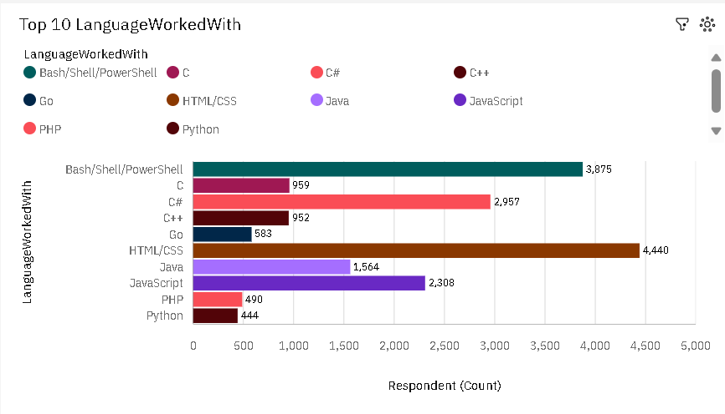
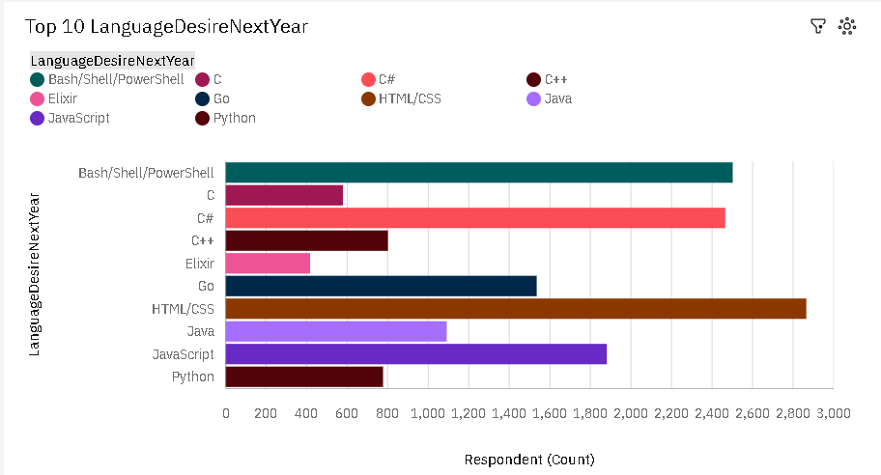
PROGRAMMING LANGUAGE TRENDS
Current Year
Next Year

Slide 8
PROGRAMMING LANGUAGE TRENDS - FINDINGS & IMPLICATIONS (Current Year)
Findings
Html/CSS are the most preferred languages to work with.
Command-line interface programming languages – Bash/Shell/PowerShell are the second most preferred languages to work with.
Python, PHP, and Go are currently used very less in comparison to the other languages
Implications
Web development is currently highly in demand and the demand in Html/CSS reflects that.
Command line interfaces are a go to for software developers for various tasks like interacting with the operating system and automation.
One reason for less demand for Python, PHP, and Gois due to better alternatives for Web development.

Slide 9
PROGRAMMING LANGUAGE TRENDS - FINDINGS & IMPLICATIONS (Next Year)
Findings
Html/CSS are still the most preferred languages to work with for the following year.
Command-line interface programming languages – Bash/Shell/PowerShell are still the second most preferred languages to work with for next year.
Underdogs of current year: Python, and Go are gaining popularity.
The numbers have reduced for most languages and now has lesser variance among the preferred languages.
Implications
Web development seems to be highly relevant in the next year.
Command line interfaces also seems to be highly relevant in the next year.
Python is gaining popularity due to exponential rise in the field if AI and machine learning.
Languages are becoming more diverse, and the trend seems to be trying to even out the huge differences in preference among respondents.

Slide 10
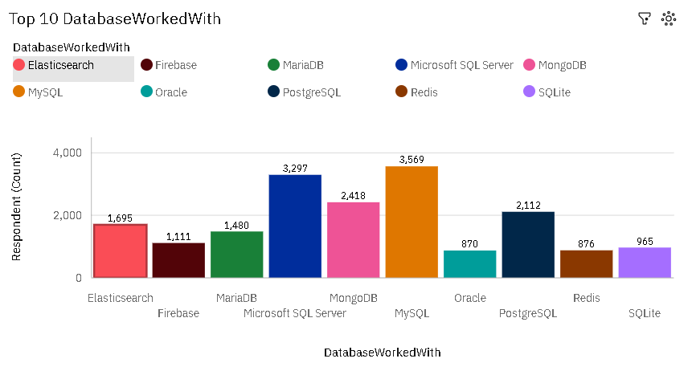
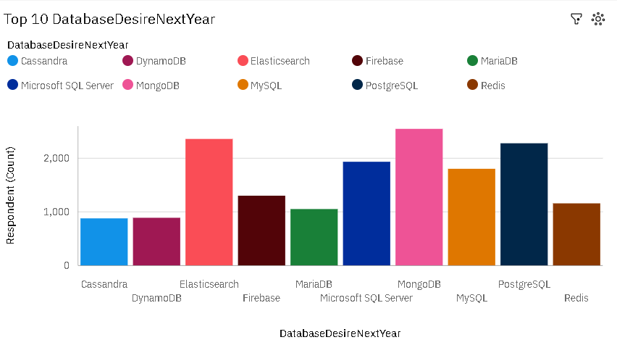
DATABASE TRENDS
Current Year
Next Year

Slide 11
DATABASE TRENDS - FINDINGS & IMPLICATIONS
Findings
MySQL and Microsoft SQL Server are the most popular database used currently.
MongoDB comes next in popularity.
MongoDB and Elasticsearch have higher preference for the next year.
PostgreSQL takes the title for most preference among the SQL databases for next year.
Implications
The popularity of MySQL and Microsoft SQL Server are the preferred relational databases for a while.
MongoDB has been the most popular non relational database.
Due to the extremely high amount to unorganized data going forward, non relational databases: MongoDB and Elasticsearch, are the most popular.
PostgreSQL could more preferred in the coming years as it has many adavntages over the other Relational Databases

Slide 12

DASHBOARD
Click to Go to Dashboard
Click to Go to Dashboard(PDF)

Slide 13
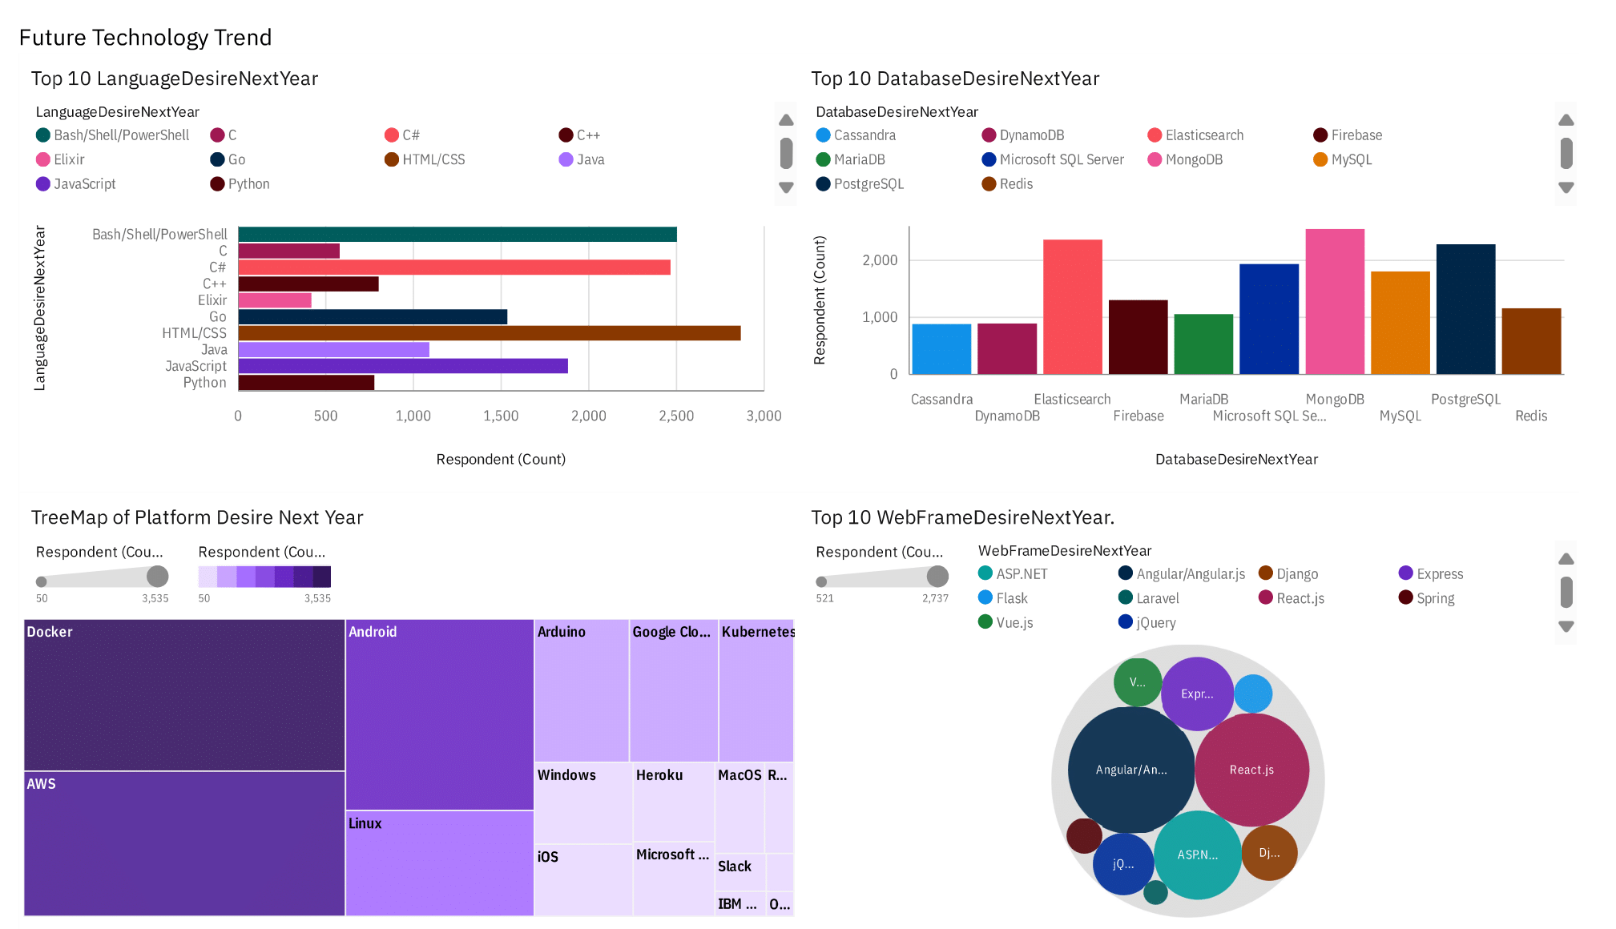
DASHBOARD TAB 1

Slide 14
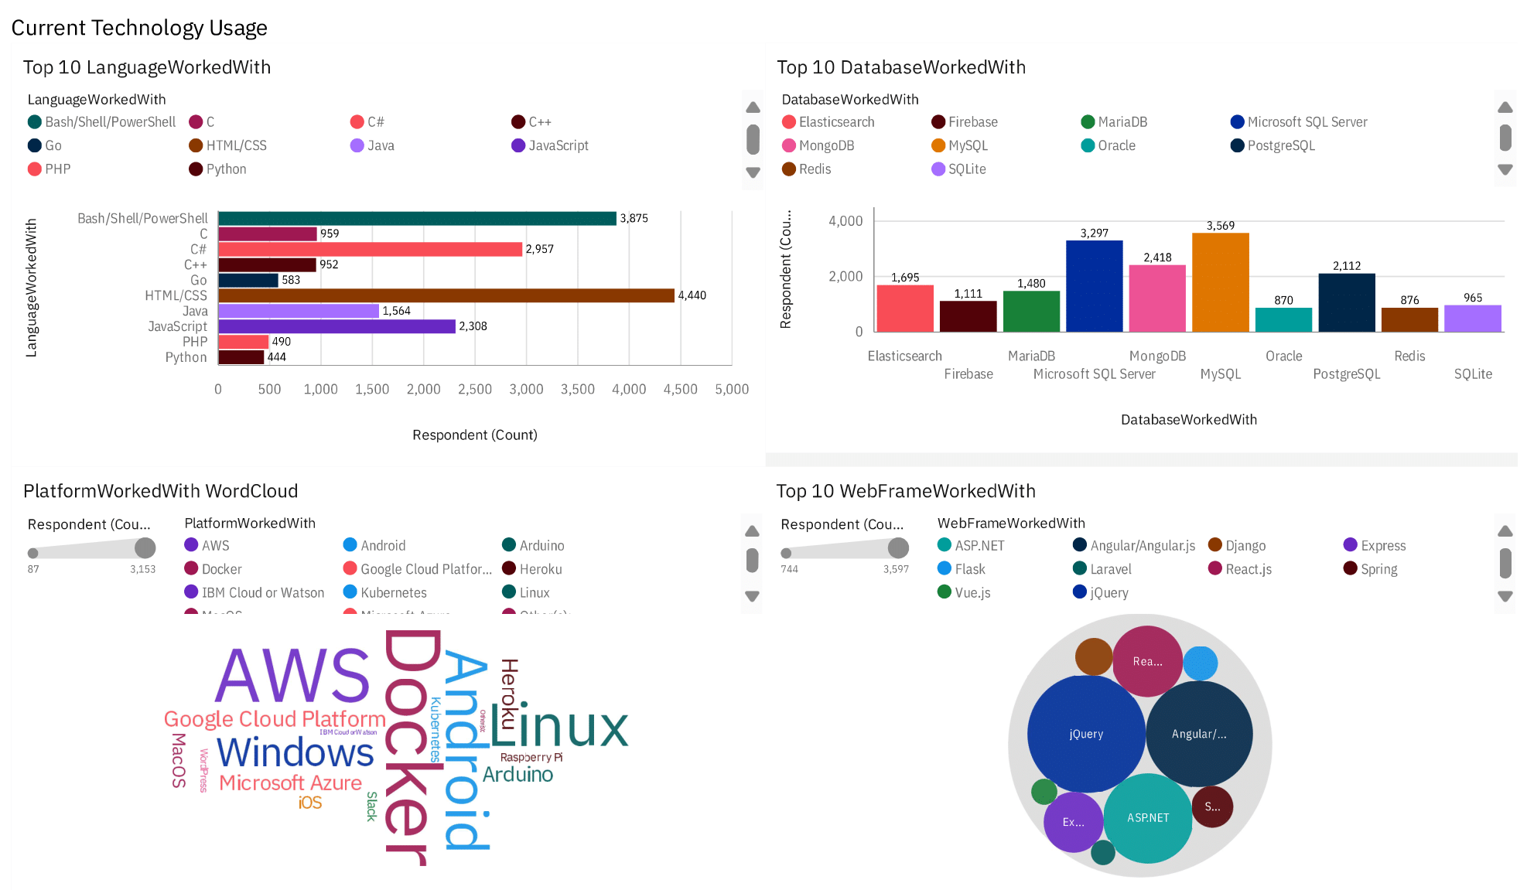
DASHBOARD TAB 2

Slide 15
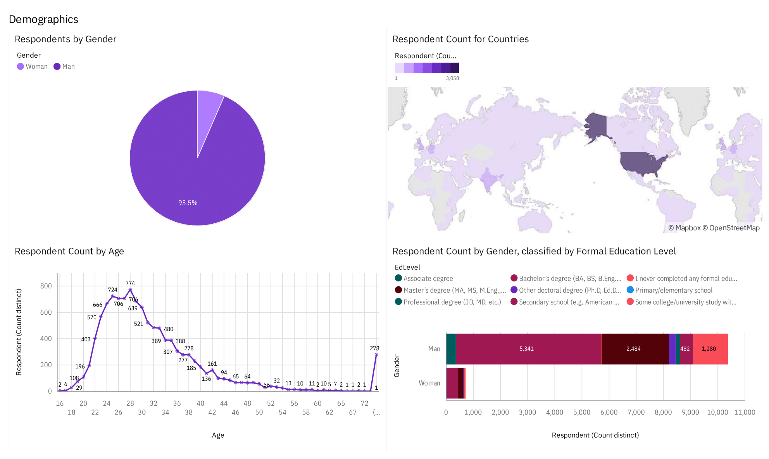
DASHBOARD TAB 3

Slide 16
DISCUSSION
What are the most popular
Languages
Databases
Platform
Who were the respondents to the data and how is its distribution?

Slide 17
OVERALL FINDINGS & IMPLICATIONS
Findings
Most of the respondents were Men of age 24-30
Html/CSS are the most preferred languages to work with this year and the next year.
Docker andAWS seems to be the most in demand platform for the future.
Implications
There is a disparity in the gender distribution in STEM fields.
Web development is very much relevant even in the coming years.
Rise in Cloud computing has helped AWS remain at the top while the ability to deploy lightweight applications brings demand to Docker.

Slide 18

CONCLUSION
Web Development remains very much relevant for the future.
Angular JS and React appears to be the demanded framework for web developers next year.
There is diversification of demand in programming languages.
Docker and AWS are very beneficial platforms to work with.

Slide 19

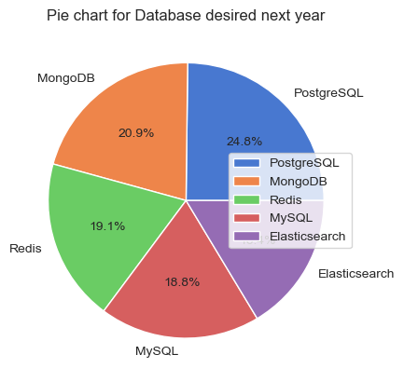
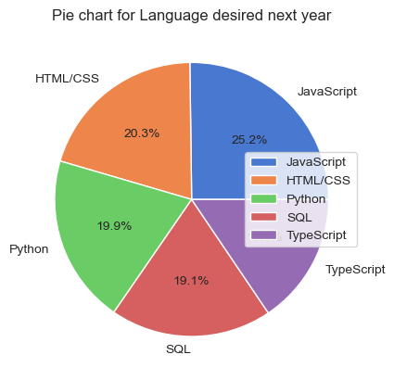
APPENDIX

Slide 20
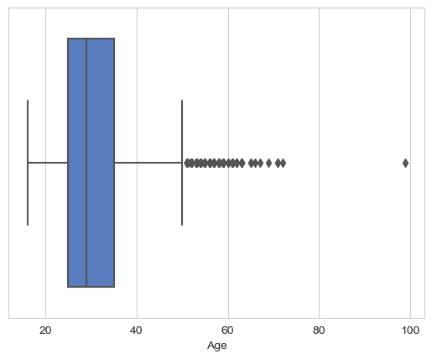
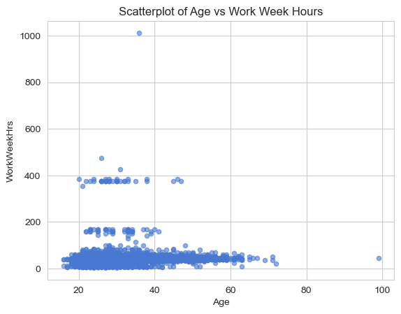
APPENDIX

Slide 21
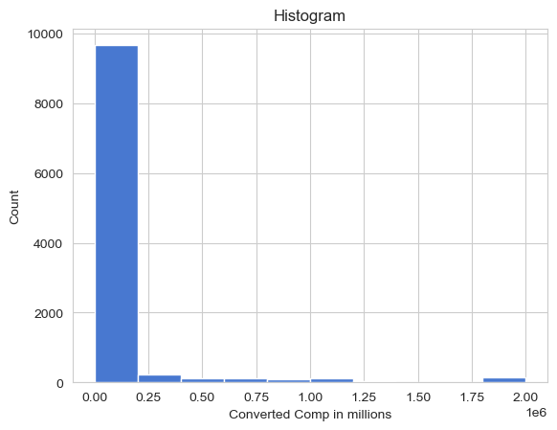
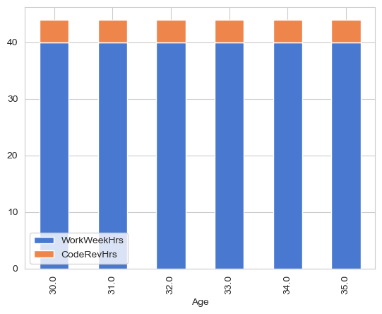
APPENDIX

Slide 22
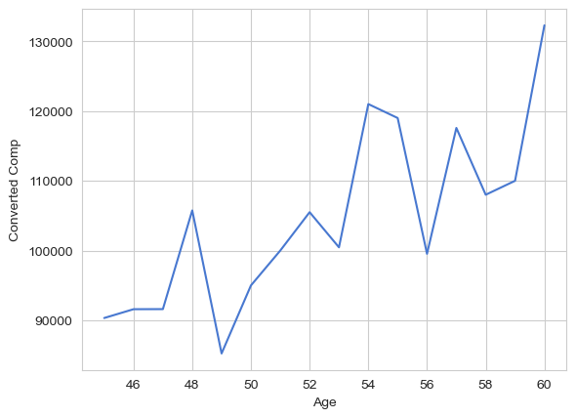
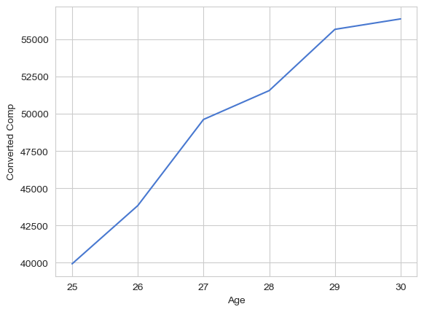
APPENDIX

Slide 23
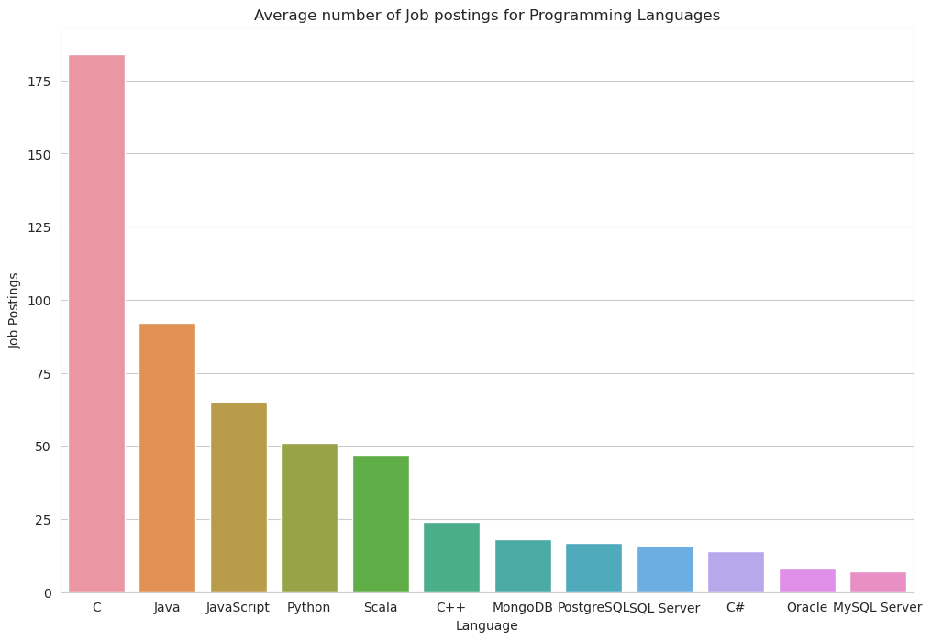
JOB POSTINGS

Slide 24
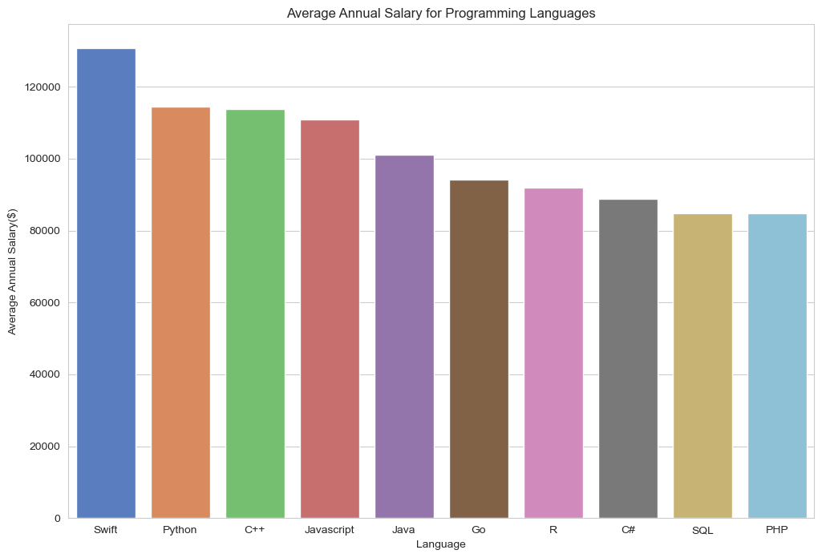
POPULAR LANGUAGES

